Slide 1



Multimodal Large Language Models
Chapter 9

Slide 2


Multimodal Models
Models that are able to deal with different types (or modalities) of data, such
as images, audio, video, or sensors, are said to be multimodal. It’s possible for a model to accept a modality as input yet not be able to generate in that modality.

Slide 3
1
In the first step of training CLIP, both images and text are embedded using an image and text encoder, respectively.
Notes:
The pair of embeddings that are generated are compared through cosine similarity.

Slide 4
2
In the second step of training CLIP, the similarity between the sentence and image embedding is calculated using cosine similarity.

Slide 5
3
In the third step of training CLIP, the text and image encoders are updated to match what the intended similarity should be. This updates the embeddings such that they are closer in vector space if the inputs are similar.

Slide 6
BLIP-2
The Querying Transformer is the bridge between vision (ViT) and text (LLM) that is the only trainable component of the pipeline.
Notes:
In step 1, image-document pairs are used to train the Q-Former to represent both images and text. These pairs are generally captions of images, as we have seen before
when training CLIP.
The images are fed to the frozen ViT to extract vision embeddings. These embeddings are used as the input of Q-Former’s ViT. The captions are used as the input of
Q-Former’s Text Transformer.
In step 1, representation learning is applied to learn representations for vision and language simultaneously. In step 2, these representations are converted to soft
visual prompts to feed the LLM.
With these inputs, the Q-Former is then trained on three tasks:
Image-text contrastive learning: This task attempts to align pairs of image and text embeddings such that they maximize their mutual information.
Image-text matching: A classification task to predict whether an image and text pair is positive (matched) or negative (unmatched).
Image-grounded text generation: Trains the model to generate text based on information extracted from the input
image.

Slide 7
Step 1 of BLIP-2 model
In step 1, the output of the frozen ViT is used together with its caption and trained on three contrastive-like tasks to learn visual-text representations.
Notes:
These three objectives are jointly optimized to improve the visual representations that are extracted from the frozen ViT. In a way, we are trying to inject textual information
into the embeddings of the frozen ViT so that we can use them in the LLM.

Slide 8
Step 2 of BLIP-2 model
In step 2, the learned embeddings from the Q-Former are passed to the LLM through a projection layer. The projected embeddings serve as a soft visual prompt.

Slide 9










TYPES OF AI
NARROW AI
GENERAL AI
SUPER AI
Narrow AI is designed to perform a specific task
General AI can perform any intellectual task that a human can
Super AI is hypothetical and would surpass human intelligence

Slide 10





HISTORY OF AI
The Dartmouth Conference, where the term "artificial intelligence" was first coined and AI was established as a field of research.
1956
The first AI system that could understand and respond to natural language was created by Terry Winograd, which marked a major step forward in natural language processing.
1974
IBM's Deep Blue defeated the world chess champion Garry Kasparov, demonstrating that machines could surpass human intelligence in specific domains.
1997
The emergence of deep learning led to breakthroughs in computer vision, speech recognition, and natural language processing.
2012

Slide 11



IN FINANCE
75%
12,000
50%
people said that AI has improved their decision-making process.
Morgan Chase used AI to analyze 12,000 commercial loan agreements in seconds
The use of AI in fraud detection has led to a 50% reduction in false positives

Slide 12








IN MANUFACTURING
Item 2
Item 3
12
10
8
6
4
2
0
2015
2016
2017
2018
2019
2020
2021

Slide 13








IN TRANSPORTATION
REDUCE 20% FUEL CONSUMPTION
REDUCE 30% MAINTENANCE COSTS
Self-driving trucks powered by AI have been shown to reduce fuel consumption by up to 20%, saving companies thousands of dollars per year.
AI-powered predictive maintenance can reduce maintenance costs by up to 30%, and increase vehicle reliability and uptime.

Slide 14






03
SOCIAL IMPLICATIONS
Explores the broader impact of AI beyond specific industries or applications. Considers ethical and societal implications such as job displacement, bias, privacy concerns, and potential impacts on democracy and human rights. Encourages a critical and thoughtful approach to AI development and deployment, taking into account the potential risks and benefits to individuals and society as a whole.

Slide 15




AI AND JOBS
JOBS AT HIGH RISK
JOBS AT SIGNIFICANT RISK
14%
32%

Slide 16



AI ETHICS
81%
People believe that companies should prioritize ethical considerations
63%
Were concerned about the ethical implications of the AI system

Slide 17
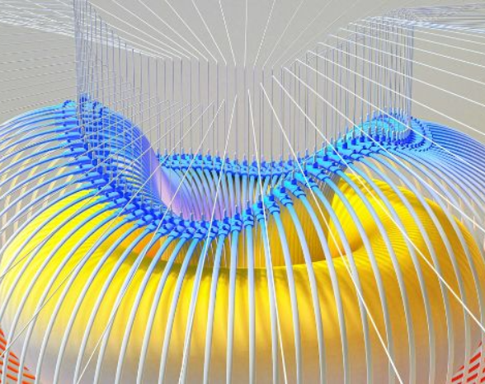

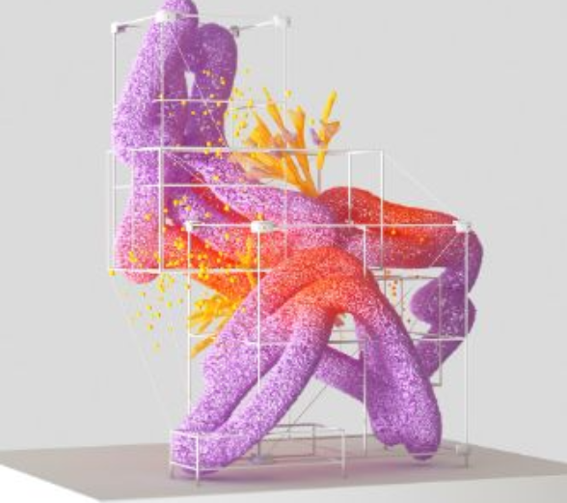

AI AND PRIVACY
A survey by Pew Research Center found that 64% of Americans are concerned about the way that companies are using their data, and 81% feel that they have little or no control over the data that companies collect about them.
20%
55%
The EU's GDPR includes provisions for ensuring that individuals have the right to access and control their personal data, including data that is processed using AI systems.

Slide 18



AI AND SOCIETY
Discusses the broader societal implications of AI, including its impact on job displacement, inequality, and social norms. This section aims to provide a comprehensive understanding of the ways in which AI is shaping our society and the challenges that need to be addressed.
04

Slide 19


THE RISE OF POWERFUL AI WILL BE EITHER THE BEST OR THE WORST THING EVER TO HAPPEN TO HUMANITY. WE DO NOT YET KNOW WHICH.
STEPHEN HAWKING

Slide 20








THANK YOU FOR
CHOOSING EATEMP
We offer free and high-quality slides templates for your presentations. We appreciate you choosing us and hope our templates have been helpful.
As a new website, we rely on your support to grow, so please help us by sharing our site with your friends and colleagues.
eatemp._
@eatemp
eatempofficial
@eatemp.official

